Slide 1


PHYSICS
PROJECT PRESENTATION
PAGE
01/15

Slide 2


ABOUT
AutoGlow
Automatic Lamp
This project is an automatic lamp that turns on when it gets dark. It uses a light sensor (LDR) to detect the surrounding brightness and switches the lamp on or off accordingly. When there is enough light, the lamp remains off, and when darkness falls, it automatically turns on. This simple yet effective system can be used for street lights, night lamps, or security lighting, making it an energy-efficient and convenient solution.
PAGE
02/15

Slide 3
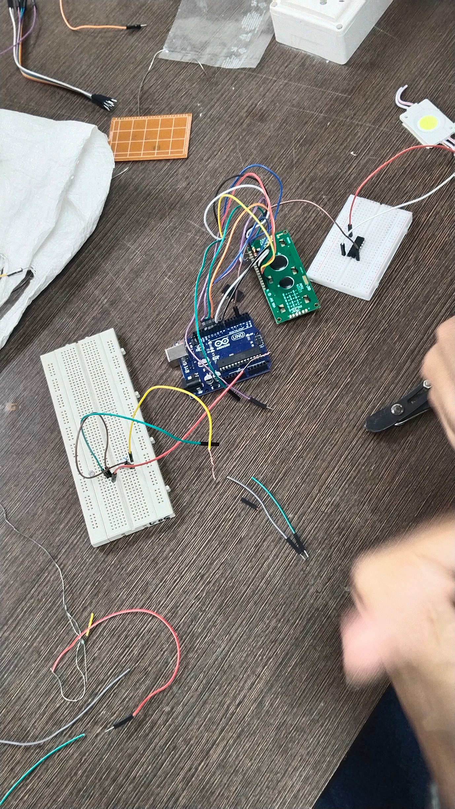


PAGE
03/15

Slide 4
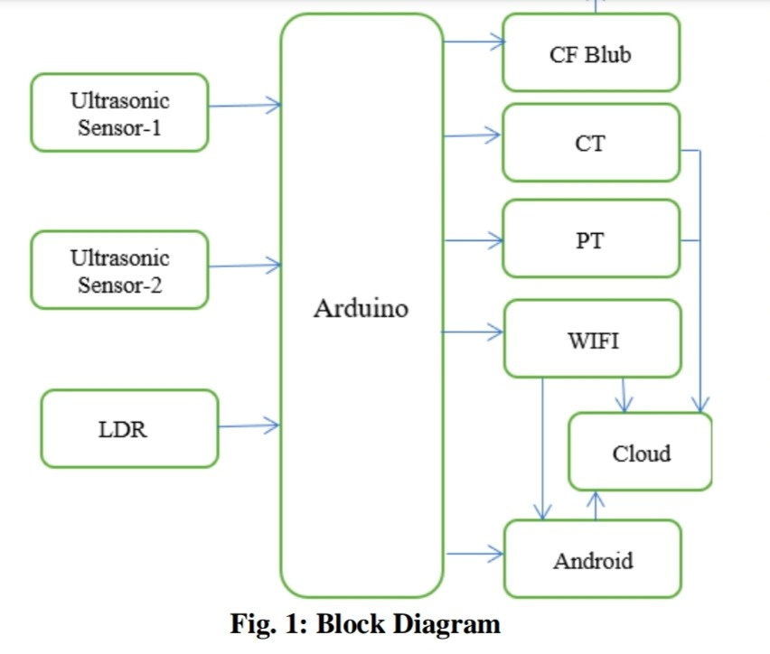
BLOCK DIAGRAM
This block diagram represents an automated system where Arduino acts as the central controller, processing inputs from multiple sensors to automate lighting and monitoring.
SENSORS AS INPUTS
ARDUINO AS PROCESSOR
AUTOMATION OUTPUTS
PAGE
05/15

Slide 5

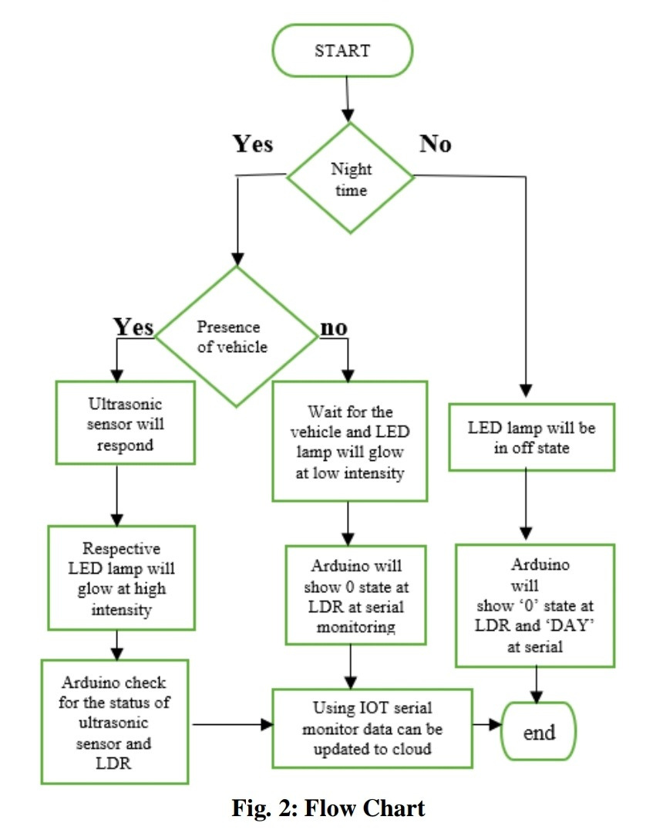
FLOW CHART
Start: The system begins operation.
Night Time Check:
If it is nighttime (detected using the LDR), the system proceeds to check for the presence of a vehicle.
If it is daytime, the LED lamp remains off, and the Arduino logs "0" state at LDR and "DAY" at the serial monitor before ending the process.
6AGE
06/15

Slide 6

ENERGY EFFICIENT
The Automatic Lamp project aims to create a smart, energy-efficient lighting system that enhances convenience and reduces electricity wastage. By integrating light sensors, the system can automatically detect darkness and turn on the lamp without manual intervention.
OUR VISION
6AGE
07/15

Slide 7

CASE 1 : ALWAYS ON LIGHT
If we consider a 5W lamp and if it remains on for the entire day, so its daily energy consumption would be :
5W x 24h = 120 Wh = 0.12 kWh
For Monthly it would be 3.6 kWh and similarly 43.2 kWh would be the yearly consumption of this lamp.
6AGE
09/15

Slide 8
CASE 2 : AUTOMATIC LAMP
Since it is an automatic lamp, let us consider that it glows for 10hrs daily.
So if we consider a 5W lamp, so its daily energy consumption would be :
5W x 10h = 50 Wh = 0.05 kWh
For monthly it would be 1.5 kWh and similarly 18 kWh would be the yearly consumption of this lamp.
6AGE
09/15

Slide 9
So if we calculate Energy Savings : -
Energy Saved Per Month:
3.6kWh−1.5kWh = 2.1kWh
Energy Saved Per Year:
43.2kWh−18kWh = 25.2kWh
So basically the Percentage Energy Savings would be : -
25.2 x 100 ≈ 60%
43.2
6AGE
09/15

Slide 10


ENERGY EFFICIENT SWITCH
By switching from an always-on light to an automatic system, you can:
✅ Save 60% of energy
✅ Reduce electricity costs
✅ Lower carbon emissions
PAGE
04/15

Slide 11


PHYSICS BEHIND THIS ? 🤔
STUDIO SHODWE
1. Light and Optoelectronics
Photoresistor (LDR) Behavior:
The resistance of an LDR ⬇️ with ⬆️ light intensity.
In bright light, resistance ⬇️ voltage ⬇️
In darkness, resistance is ⬆️, voltage ⬆️ and triggering the lamp💡
6AGE
08/15

Slide 12
PHYSICS BEHIND THIS ? 🤔
STUDIO SHODWE
2.Power and Energy Efficiency
Power Calculation : 𝑃 = 𝑉• I
1. Helps measure and compare power consumption.
Energy Savings :
1. Applying automation reduces energy waste, demonstrating efficiency principles.
3. Environmental Physics
Reducing electricity usage lowers carbon footprint, promoting sustainability.
6AGE
08/15

Slide 13

VIDEO
6AGE
10/15

Slide 14

THANK YOU!
PAGE
15/15

